Slide 1
Academic GUM Training
Dr Manik Kohli ST6 GUM/Internal Medicine & NIHR Doctoral Research Fellow
Institute for Global Health, UCL
Mortimer Market Centre, London
NIHR Academic Clinical Fellow 2020-2023

Slide 2
Outline
Integrated Academic Training
My journey
What do Academic GUM doctors do?
Life as an ACF
So, you're thinking about a PhD?
Top tips

Slide 3
It is much more enjoyable to do research when you are genuinely interested in the question.

Slide 4
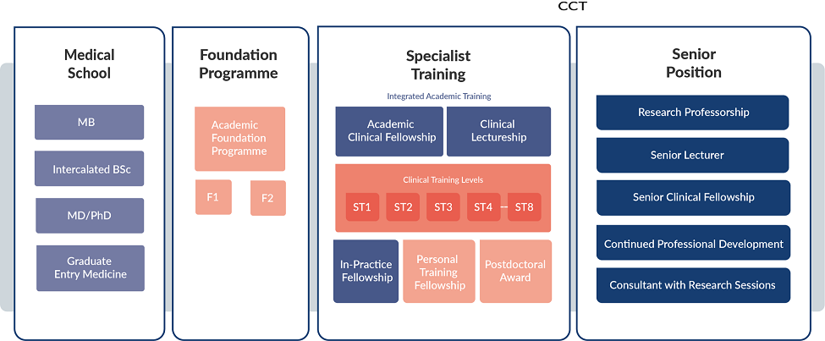
IAT
PhD/Doctoral Fellowship
> ACF – 25% Academic / 75% Clinical (3 years)
> CL – 50% / 50% (up to 4 years and can CCT within)
> Some locally funded ACF posts
> GUM ACFs (mostly) start at ST4

Slide 5
How did I end up here?
Interest
Chance
Networking
Persistence
By Accident

Slide 6
My journey
Medical School & BSc
Foundation Programme
MSc in Reproductive and Sexual Health Research
CMT (IMT)
GUM Reg Training
Academic Clinical Fellow & GUM SpR
Clinical Research Fellow & PhD
→ NIHR Doctoral Fellow
No interest in research
Maybe interested
Definitely interested in research
1st ever publication

Slide 7
My journey
Applied to MRC for PhD Fellowship:
unsuccessful
Applied for ACF: unsuccessful
Medical School & BSc
Foundation Programme
MSc in Reproductive and Sexual Health Research
CMT (IMT)
GUM Reg Training
Academic Clinical Fellow & GUM SpR
Clinical Research Fellow & PhD
→ NIHR Doctoral Fellow
Re-applied to NIHR for PhD Fellowship:
SUCCESS
Reapplied for ACF - SUCCESS

Slide 8
My PhD & research interests
DoxyPEP (doxycycline post-exposure prophylaxis) & STI prevention
Antimicrobial resistance & microbiome
Incorporates clinical research, sexual health, public health, microbiology, molecular epidemiology, LGBTQ+ health & community collaboration

Slide 9
What do academic GUM doctors do?
Clinical Trials
Epidemiology & Population health
Laboratory Science
Social Research
and more…
Viral hepatitis
Vaccines & immunotherapy
HIV cure
Novel antibiotics
STIs
HIV
Antiretrovirals
PrEP
Antibiotic resistance
HIV cure
Stigma
Sexuality
Barriers & Facilitators
Motivations, Behaviour & Attitudes
Health needs
Experiences of healthcare
LGBTQ+ health
Global Health & Research in LMICs
Digital Health & AI
Sexual behaviour & attitudes
OIs & TB
HIV/STI prevention
Viral hepatitis
Virology
Immunology
Microbiology
HIV & multimorbidity
Migrant Health
Policy Research
Reproductive Health
HPV IN/cancer
Lab aspects of clinical research
HIV & multimorbidity
STI genomics (molecular epi)
Molecular epidemiology
DESIGINING | FUNDING PROPOSALS | IMPLEMENTING ANALYSING | DISSEMINATING | ENGAGING

Slide 10
Life as an ACF
My time
My work
Other perks
9 months academic time within specialty training (across 3 years)
Flexible (100% academic blocks, 50/50, 80/20)
Clinical trials clinic – recruit and follow-up patients in HIV/STI interventional studies
Developing my own research question, proposal, and funding applications for PhD
Small projects – analyse clinical data, data from other studies, literature review
Conferences and courses (ACF study budget & other funds)
Formal and informal mentorship
Submit abstracts to conferences / papers for publication
An office and my own desk
Work-life balance: flexible working during academic time
Access to journals and resources through the university

Slide 11
So, you’re thinking about a PhD?
I was not sure until after I started ACF
ACF time > help develop PhD proposal and get funding
You DON’T NEED an ACF to do/apply for a PhD!
Interested in research but don’t want to commit to a PhD – THAT’S FINE
Supervisors/departments
> may have an idea or project ready to go
> encourage and support you to develop your own idea

Slide 12
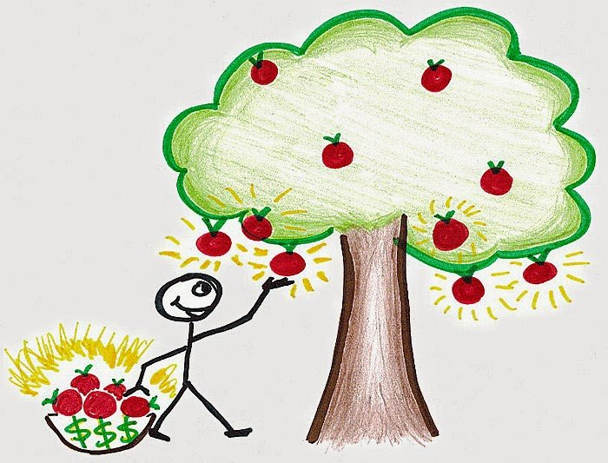
Top Tips
BE PERSISTENT
TAKE YOUR TIME
LOW HANGING FRUIT
NETWORKING
BE OPEN MINDED
SAY YES / SAY NO

