Slide 1
Genitourinary Medicine Taster 14th Oct 2024 Recruitment, the Curriculum and its Delivery
Dr Katia Prime
Consultant Genitourinary Medicine
St George’s Hospital
GUM SAC curriculum lead

Slide 2
Objectives
Recruitment
Process, timelines, application & interview
Curriculum
Content, dual accreditation GUM/IM, implementation
Q&A

Slide 3
Recruitment 2024
March/April R1, Oct R2: England, Wales & Scotland
Physician Higher Specialty Training Recruitment is managed and coordinated by the Physician Specialty Recruitment Office (PSRO) based in NHS England
https://www.phstrecruitment.org.uk/specialties/genitourinary-medicine
GUM: coordinated virtually by E Midland Deanery
Rotational info available on Deanery webpage eg London: https://london.hee.nhs.uk/specialty-schools/medicine-and-medical-specialties/genitourinary-medicine
Academic: ACF/ACLs separate process

Slide 4
Academic GUM Training
https://www.catch.ac.uk
GUM: J.Vera@bsms.ac.uk
Imperial
UCL
Brighton
https://www.bsms.ac.uk/research/global-health-and-infection/research-areas/hiv-sexual-and-womens-health.aspx

Slide 5
Recruitment 2024/5
Full MRCP is a requirement for entry to ST4 programmes
Candidates self-score their application form according to set criteria for several domains
(eg qualifications, presentations, publications, teaching, QIMP)
Candidates upload evidence to verify self-score
Self-score is then checked by GUM recruitment leads, who can amend self–scores up or down
Applicants rank preference of Deanery & post
Interview
Discussion & ranking
Offers to highest scoring first
Holding period

Slide 6
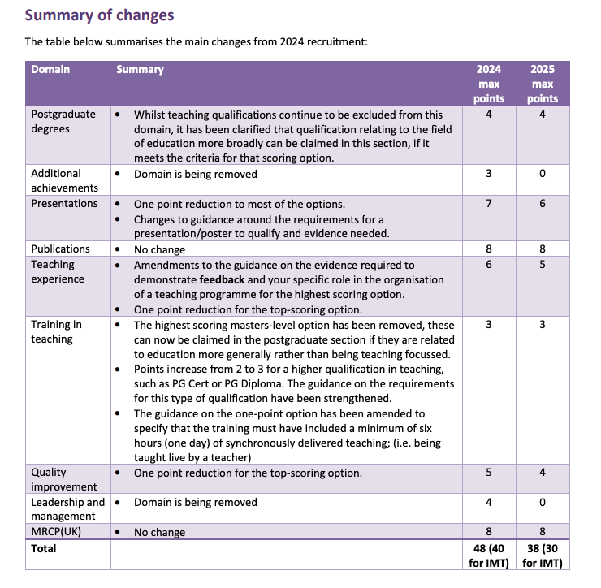

Slide 7
GUM Recruitment 2024
High number of vacancies
High chance of being appointed into preferred geographical area for suitably qualified candidates
Prior experience in GUM is not essential!
Candidates should be
Keen to learn
Passionate about sexual health
Motivated to seek out learning opportunities

Slide 8
What makes a GREAT application?
Knowing what the specialty is about
(Experience)
Sitting in clinics
Teamwork in MDT
Communication skills
Courses – STIF, DFSRH
Teaching-participation with feedback & qualification/training
Audit/QIMP/SSC
Research/Publications/Book chapters
Evidence should be well organised
Label documents with specific domains
Avoid over-scoring: honesty is better than awarding a higher self-score than is merited
All documents are thoroughly checked and points can only be awarded on the basis of the evidence provided
Notes:
Eg do not say you have completed 3 cycles of a QIP if you only upload an outline plan of cycle 1
Teaching domain – requires feedback from people taught to get any points
Leadership domain – requires that candidates can demonstrate “making an impact” not just having held a position in a committee

Slide 9
Recruitment 2024
INTERVIEW PROCESS-VIRTUAL
4 stations, 10 mins per station
Interview pair 1
Station 1
Clinical scenario and Communication skills
5 mins reading time, 10 mins Qs
Station 2
Suitability for Medical Registrar role
Scenario given to all ST4 medical specialties who are dual training with GIM
Draws on core skills via real life examples of managing patients seen in acute medicine
10 mins Qs
Interview pair 2
Station 3
Ethical scenario
5 mins reading time, 10 mins Qs
Station 4
Suitability for and commitment to specialty
Interviewers can see application forms
4 min verbal presentation, 6 mins Qs

Slide 10
What makes a GREAT interview?
Gets you the job!
Enthusiasm
Demonstrating knowledge about specialty
Communication skills
Case scenarios
Organised, senior support
Clinically competent, patient safety
Non-judgemental
Team player in MDT
Aware of current issues relating to specialty
Eg recent journal article, conference round up, commissioning, Prep, STI Ab resistance
Transferable skills outside medicine/specialty
Notes:
Clinical scenarios designed to check you are clinically safe; that you have appropriate knowledge to assess patients and seek help; and that you understand core concepts such as HIV testing.
It is possible to do well even if you are not aware of the specific management of the GUM presentation.

Slide 11
Any Qs on Recruitment?

Slide 12
GUM specialty training from 2022 onwards

Slide 13
Training for GUM physicians
Two years foundation training after qualification
Then 3 years Internal Medicine Training (IMT years 1,2,3=IM Stage 1) leading to MRCP(UK)
Or 4 years ACCS-IM
Selection to 4 year GUM/IM specialty training programme
Includes GUM plus IM Stage 2
Acute take participation in addition to specialty take
Specialty specific exams. No plans for new exit exam

Slide 14
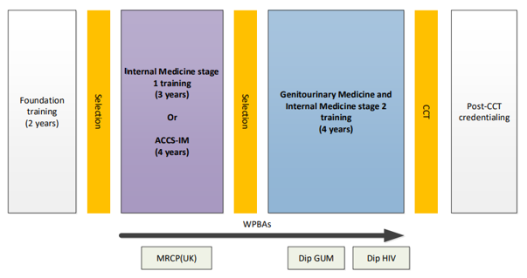

Slide 15
Group 1 specialties (dual train with Internal Medicine) | Group 2 specialties (single CCT)
Acute Internal Medicine | Allergy
Cardiology | Audio vestibular Medicine
Clinical Pharmacology and Therapeutics | Aviation and Space Medicine
Endocrinology and Diabetes Mellitus | Clinical Genetics
Gastroenterology | Clinical Neurophysiology
Genitourinary Medicine | Dermatology
Geriatric Medicine | Haematology
Infectious Diseases | Immunology
Neurology | Infectious Diseases*
Palliative Medicine | Medical Oncology
Renal Medicine | Medical Ophthalmology
Respiratory Medicine | Nuclear Medicine
Rheumatology | Paediatric Cardiology
 | Pharmaceutical Medicine
 | Rehabilitation Medicine
 | Sport and Exercise Medicine
*When dual with Medical Microbiology or Virology

Slide 16
Dual accreditation in GUM + IM
From 2022, all new GUM trainees will commence a training programme for both GUM plus Internal Medicine Stage 2 (IMS2)
There will be no opt-out to drop either GUM or IM and obtain single accreditation
New curricula for IMS2 & GUM available on the Federation website

Slide 17
https://www.thefederation.uk/training/specialties/genitourinary-medicine
Specialty Training Curriculum for Genitourinary Medicine Sept 2016
Curriculum for Genitourinary Medicine/IM Training Aug 2022

Slide 18
The GUM Curriculum
Years 1 and 2 ST 4-5
GUM
HIV CLINICAL EXPERIENCE
Gynaecology
Contraception
Audit/QIMP
Teaching
Years 3 and 4 ST 6-7
Complex GUM
Complex HIV COMPLEXITY
Dermatology
Lab block
Management/Leadership
Public Health
Audit/QIMP
Research
Dip GUM end ST6, Dip HIV end ST7
(Loc SDI (Implanon), Loc IUT, DFSRH)
OOPE years 2/3?: MD, PhD, teaching/Darzi/BASHH fellow, ethics, sustainability

Slide 19
Dual accreditation in GUM + IM
Indicative minimum 12 months training in continuing ward care of patients admitted with acute medical problems (Internal Medicine Stage 2) and 3 years specialty GUM training
Indicative 750 patients presenting with acute unselected medical problems, 100 in final year
IMTS2 “blocks” during 4 years of training
‘Blocks at least 3 months long and at least 3 months IMTS2 in final year
Flexible models for local amendments and implementations
3 months of HIV/ID attachment can count towards IMTS2
Longitudinal aspects maintained to prevent need for repeated RTT periods, e.g. GUM/HIV clinics during IMT, AMU shifts during GUM
Need for HDU/ITU contact-during HIV or IM attachments
Palliative care attachment highly recommended
20 outpatient clinics in non-parent specialty

Slide 20
Implementing the new curriculum
IM Educational Supervisor and annual ARCP required
WPAs proportionately representing time spent in IMS2 or GUM
Timing of Dip GUM & Dip HIV will need to be planned for by trainees & trainers
Trainees may need to work between different providers when the GUM service is not in the acute sector

Slide 21
New curriculum: GUM & IM
Update GUM curriculum in line with the GMC’s Excellence by Design standards (2017)
Incorporating Generic Professional Capabilities (GPCs).
Curricula now required to be based around high level learning outcomes (Competencies in Practice-CiP)
CiP: A task/responsibility entrusted to a learner to execute unsupervised once enough competence has been achieved
Notes:
GMCs good medical practice embedded in all GPCs:1. professional knowledge, 2. professional skills, 3. professional values & behaviours, 4. health promotion & illness prevention, 5. leadership & team working, 6. patient safety & quality improvement, 7. safeguarding vulnerable groups, 8. education & training

Slide 22
New curriculum: GUM & IMT
22 CiPs:
6 generic
Work within NHS/management systems, ethical/legal issues, communication/professional behaviour, patient safety/quality improvement, teaching/supervision, research/data management
8 IM
Managing OP, acute & specialty take, medical IP, managing medical problems in patients from other specialties, managing an MDT & discharge planning, resus & managing acutely unwell patients, end of life & palliative care skills
8 Specialty (GUM)
9 GPCs. Mirror GMCs good medical practice domains. Embedded within generic, IM & specialty CiPs
Professional: values/behaviour, skills, knowledge
Capabilities in: health promotion & illness prevention, leadership & team working, patient safety & quality improvement, safeguarding, education & training, research & scholarship

Slide 23
GUM CiPs
8 specialist GUM CiPs:
Delivering a sexual health out-patient clinic
Managing complex sexual health presentations
HIV out-patient care
Specialist HIV in-patient care
Prevention of HIV, BBV and STIs
Early detection of HIV & STIs in all settings
Safeguarding public health & targeting populations
Service management and commissioning

Slide 24
GUM vs CSRH
GUM Physician-led specialty, focused on sexual health, STIs & HIV | CSRH Rooted in gynaecology, focused on reproductive health and contraception
Complex STI care | Basic STI care
Basic contraception care | Complex contraception care
Specialist HIV prevention | Abortion Services
Specialist HIV care | Menopause/PMS care
Internal Medicine | Medical gynaecology

Slide 25
TPD/Educational leads: https://lovegum.bashh.org/resources.aspx

