Slide 1
GU Medicine in a non-urban area
Dr Nadia Khatib
Consultant GU/HIV Medicine Torbay and South Devon NHS Trust
14.10.24
Notes:
I have been asked to give a talk about working in a non-urban setting. Although I am definitely not an expert in this area but I do work in deepest darkest Devon and I’m very happy to share my experiences with you.

Slide 2
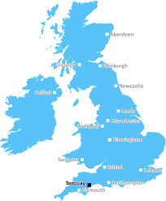

Slide 3
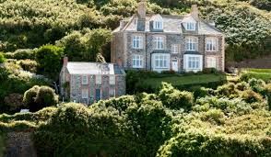
Notes:
If there are any eagle eyed ITV sitcom fans among you, you may recognise this as the surgery and home of the fictional GP Doc Martin who sets up as a GP in idyllic rural Cornwall. But working as a GU Med consultant in Devon is not quite like that. I work in this not so beautiful building on Torquay High Street.

Slide 4
My Background
Dubai, Manchester, Newcastle
1999 – 2004: University College London
2004 – 2009: London, incl GU Med at Chelsea & Westminster
2009 – 2015: SpR training at West Midlands Deanery based in Coventry and Birmingham
2015: Consultant job decision time
Notes:
So how did I get here?
After primary school in a Northern English town, until I moved to Devon, I lived, studied and worked in the heart of big cities
After secondary school in Dubai, working in Manchester and doing a Psychology degree at Newcastle, I went to medical school and did all my training before registrar level, in London. That included a Trust Grade job at a very big and very busy Sexual Health clinic at C&W in London. I did my registrar training between Cov and B’ham at LTFT because I had 2 kids during that training. I only mention them because having kids did influence the career decisions I made later.

Slide 5
“You’ll never see syphilis again!”
“I doubt they even have sex in Devon”
Notes:
I applied for 3 jobs and got 3 interviews.
I went to visit all 3 clinics, decided against moving forward with one and saw 2 of them the following week. I sent my husband a picture of the view from near each clinic – 1 urban and 1 not and asked him where he’d rather live.
He was very clear in his response. And mainly because I thought it would be a better place for our family to live – better schools, more affordable housing and because I love the sea and the outdoors, I wanted to move here too.
But I had a lot of people telling me I was passing up a great opportunity and I quote….

Slide 6
Clinical – GU medicine
I’ve seen lots and lots of syphilis……and the rest
They have lot and lots of sex in Devon
What we do see:
Poverty
Stigma
What we don’t see much of:
Chemsex
Mpox
LGV
Shigella
Notes:
It is true that rates of poverty are higher in urban than in rural UK BUT
In terms of social deprivation, Torbay 48th out of 317 LAs for being most deprived
All the general health, mental health and sexual health challenges a/w that still exist
Torbay has higher than national rates of abortion, much more so in under-18s and this hasn’t fallen in recent yrs, unlike rest of England.
Rates of DA are among highest in country; mental ill health issues and addiction.
It’s really not idyllic.
In terms of LGBTQ issues, felt like I’d moved from B’ham to the 1950s.
EVERY single new hiv diagnosis in yr 1 (only 8) was a ‘straight’ married man. Men don’t hold hands, never mind kiss, in the street; the gay scene is much more hidden.
All national prevention campaigns that I’d been a part of in London and Birmingham seemed really irrelevant and felt locally, a different approach with a different target group, was needed.
BUT I remember asking a consultant in B’ham why ID at Heartlands, in v deprived area – v interesting medicine.
Most people go into GU Med with a desire to support those most marginalised in society, lots of opportunities for education, fresh ideas about prevention, champion those issues that are taken for granted in big cities. I have felt like much more of an advocate for patients than I felt the need to be in London or Birmingham.
Lots of GBMSM but a higher proportion in more stable relationships, moved to Torbay in later life. Not big enough to have enough people for large sexual networks. It’s activity within networks like that which is a/w chemsex and with STIs such as Mpox and LGV.
Lack of wider support – BUT you are the expert. Can feel like a privilege.

Slide 7
Clinical – HIV
Birmingham – 3000+ patients
Torbay – 200 patients
5 HIV Consultants
5 ID Consultants
6 CNSs
Occupational Therapist
Pharmacist
Dietician
Psychologist
Midwife
On site social and peer support
Specialist Clinics: Metabolic, Renal, TB, Adolescent, Pregnancy, Frailty
Me and 1 CNS
Notes:
Moving on to HIV. Where I trained…..
So you’d think this was a negative but it really hasn’t been. It’s actually been one of the best parts of moving somewhere smaller

Slide 8
Clinical - HIV
Need SpR training to be very good
Need to maintain support networks
Need to build support networks – regionally for HIV and locally for cross specialty advice
Focus on keeping up with CPD
Holistic approach
Can shape services more easily
Notes:
You do need to have had really good training because you need to be clinically confident in what you are doing. I also really benefited from keeping up contact with my colleagues in B’ham so in the early days, I regularly tapped into their HIV MDT Meetings. I really worked hard to build and maintain good clinical networks. And really actively make sure you keep up with what’s going on nationally because you are the local expert. No one will tell you that guidelines have changed – you’ll be telling others.
But it’s great. You realise that for your small cohort, who you get to know incredibly well, you don’t need a huge team of experts. You can be the Holistic: Pharmacist – adherence, interactions, educating colleagues; Peer support for patients; good and close relationships with DAS, Housing department.
Shape: Nurse led clinics, communication with Primary Care, building relationships with Secondary Care team

Slide 9
Ethnic diversity
There is very little of it
Notes:
I wasn’t sure whether to mention this, but this is supposed to be an honest account of rural living and working and it is the aspect of living and working here that I dislike the most. 98% of patients are White. Most staff are White. I’m obviously White but with a foreign name. My husband is White but Irish with a strong Irish accent. And we both experienced racism within weeks of being here. Which is inconceivable that that would happen in any large UK city, Then my Brown Jordanian dad moved here to be closer to us and said it felt similar to when he first moved to B’ham in the 70s. Impossible to put a positive spin on that. Be active in trying to mitigate the effects of that. On yourself and on your family.

Slide 10
Career opportunities
Not so much….
Research
Private practice
Plenty of….
Education
Leadership
Quality improvement
Variety
Notes:
Moving away from Clinical Issues…and on to the other aspects of work that are important.
I think if either research or private practice are important to you, it would be important to look closely at the opportunities to do those things before making a move to a rural setting. No dedicated research team, need to be active in seeking out research activity, do not expect to be selected for large drug trials. Don’t get me wrong, there are opportunities, especially as there has been a drive by the NIHR to make research opportunities be available in smaller centres. Have been successful but only because of connections made during training.
Limited opportunities for private work

Slide 11
Geographical
Challenging for patients
Remote testing
Travel++ for FTF
Continuity
Patients keep coming back
Think about it for CPD
Virtual Conferences
Travel++ for FTF
Notes:
Access
Dartmouth YP

Slide 12
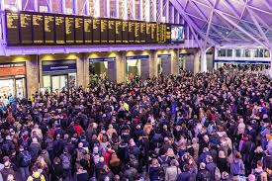
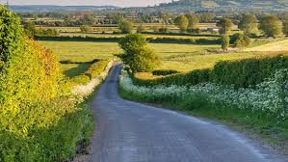
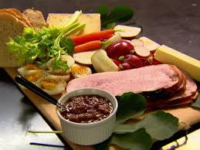
Lifestyle

Slide 13
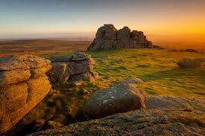
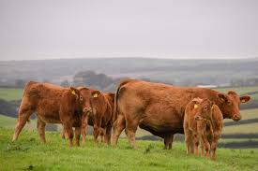
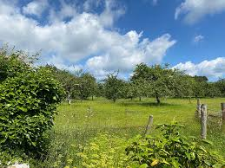
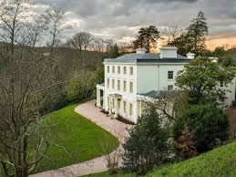
Lifestyle
Notes:
Housing
Schools
Hobbies
Transport

Slide 14
Any questions?

