Slide 1
RESEARCH OPPORTUNITIES AND
OUT-OF-PROGRAMME EXPERIENCES IN GUM
DR DAVID LAWRENCE
KING’S COLLEGE HOSPITAL
LONDON SCHOOL OF HYGIENE AND TROPICAL MEDICINE
GUM TASTER DAY – 14th OCTOBER 2024

Slide 2
Out of Programme Opportunities
OOP = out of programme (Overall 3 year max)
OOPE = out of programme for clinical experience (1 year max)
OOPR = out of programme for research
OOPT = out of programme for approved clinical training
OOPC = out of programme career break

Slide 3
OOPE
OOPR
OOPR extension
Training started: 09/2016
CCT date: 11/2026
OOPR extension 2
Academic Foundation Programme
LTFT 80%
CT1 and ST3
LTFT 50%
2012-2014
2014-2017
2017-2021
2021-present

Slide 4
Cryptococcal meningitis is a leading cause of AIDS-related death globally
PRESS RELEASE
Millions of lives at risk as progress against AIDS falters
“The AIDS pandemic took a life every minute in 2023, with 630 000 AIDS deaths despite effective HIV treatment and tools to prevent, detect, and treat opportunistic infections”
UNAIDS Global AIDS Update 2024
Nearly all of these deaths are among people with advanced HIV disease (those with severe immune suppression)
UNAIDS Data 2021
3 leading causes of AIDS-related deaths:
Reducing cryptococcal meningitis deaths is essential to end AIDS by 2030
UNAIDS Political Declaration on HIV and AIDS 2021: Ending Inequalities and Getting on Track to End AIDS by 2030
Cryptococcal meningitis
Tuberculosis
Bacterial infections
Notes:
There has been huge progress in the public health response to the HIV pandemic over the past two decades, but we still face significant challenges. UNAIDS estimate that there were 650 thousand deaths due to AIDS in 2021; one life lost every minute of the year. And based on current trends we will be far from our target of ending AIDS deaths by 2030.
Nearly all these deaths occur in people with very advanced immune suppression. Despite widespread roll-out of antiretroviral therapy many people are still unable to access treatment until late in their disease course, and an increasing population are at risk of developing advanced HIV disease, or AIDS, after treatment failure due to difficulties engaging with treatment services and adhering to lifelong medications or development of drug resistance.
Three types of opportunistic infection are responsible for the majority of AIDS-related deaths: invasive bacterial infections, tuberculosis, and cryptococcal meningitis. Cryptococcal meningitis, an infection that many outside the medical community may never have heard of, is responsible for almost 20% of all AIDS-related deaths globally. And effective strategies to tackle cryptococcal meningitis are essential in order to end AIDS deaths.

Slide 5
Cryptococcal meningitis is extremely difficult to treat
Treatment Mortality rate
Cryptococcal meningitis is 100% fatal if left untreated
Across most of Africa treatment has been based on oral therapy with fluconazole tablets
Conventional intravenous treatments are more effective but require prolonged courses of therapy with very toxic medications
New simple treatments for cryptococcal meningitis that can be given in resource limited settings are urgently needed
100%
70%
40%
??
Notes:
Cryptococcal meningitis is caused by a fungus that is widespread in the environment. In individuals with low CD4 counts due to advanced HIV disease it leads to a devastating infection of the brain, with excruciating headaches, coma, and eventually death in all individuals who don’t receive treatment. Unfortunately, treatment of this severe infection is very difficult. Across most of Africa treatment has been, and still is, based on therapy with a single oral medication, fluconazole. This is easy to administer as tablets, but really inadequate when used in isolation, with 70% or more individuals treated in this way still dying.
Intravenous therapy with a drug called amphotericin is more effective, but requires between 7 to 14 days of daily intravenous infusions, and causes significant drug related toxicities including kidney damage and anaemia, making safe use very difficult in most resource constrained hospitals. And mortality rates with this treatment are still far from acceptable, with 40% or more dying within the first few weeks of therapy.
It was clear that new simple treatments for cryptococcal meningitis that can be given in resource limited settings were urgently needed to effectively deal with advanced HIV disease in Africa.

Slide 6
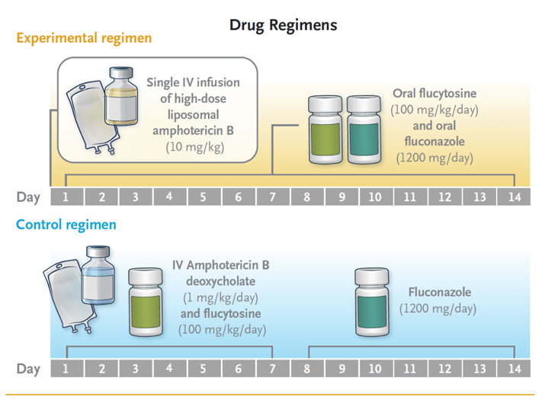
Defining a new treatment for cryptococcal meningitis
Single high-dose liposomal amphotericin based regimen for treatment of HIV-associated Cryptococcal Meningitis: the phase-3 Ambition-cm Randomised Trial
Notes:
Funding for cryptococcal meningitis and other HIV related opportunistic infections has historically been very limited, with much of the HIV research focus on prevention and antiretroviral treatment. Fortunately, the EDCTP programme provided us with opportunity to apply for funding to address this critical research need, and in 2016 we were awarded a grant for The AMBITION trial – a multinational collaborative partnership between leading research institutions in Botswana, Malawi, South Africa, Uganda, and Zimbabwe, and European partners in France and the UK.
Based on over a decade of laboratory-based research, animal models, and clinical trials work we developed a simplified treatment regimen for cryptococcal meningitis based on a single high-dose intravenous infusion of a newer formulation of amphotericin called liposomal amphotericin. We hoped that this would offer a highly effective treatment that could be easily and safely administered even in the most basic healthcare facilities, and that would also be significantly safer than existing treatments.
The trial design is shown here. We compared our experimental treatment consisting of the single intravenous infusion on day 1 followed by two weeks of tablets to the then WHO recommended first line treatment requiring 7 daily intravenous infusions of the conventional and more toxic amphotericin formulation. Between 2017 and 2021 we enrolled over 800 people with cryptococcal meningitis into the trial at eight hospitals across the five participating African countries. Our primary outcome was the proportion of people who survived when given the new treatment compared to the proportion who survived with control treatment.

Slide 7
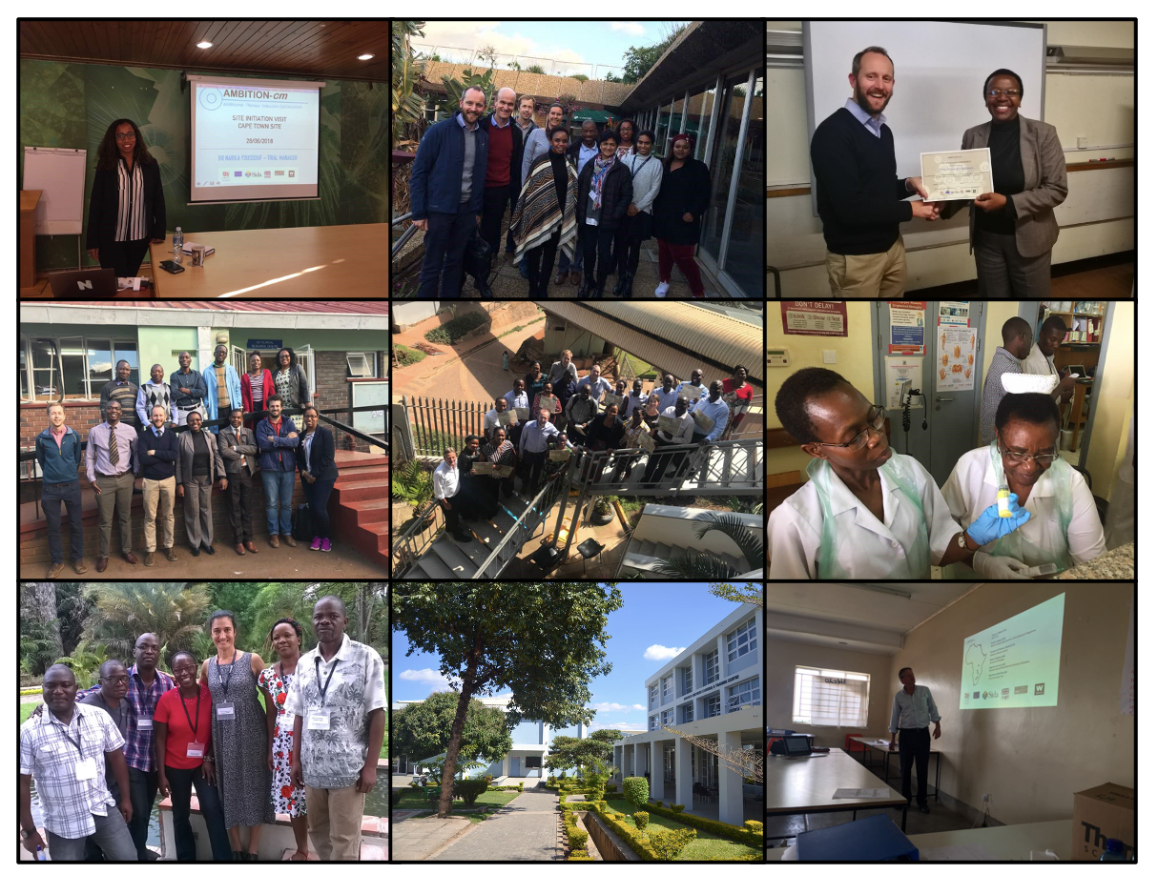

Slide 8
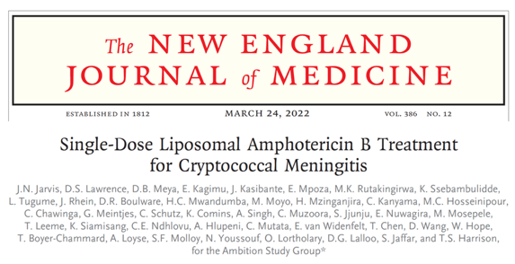
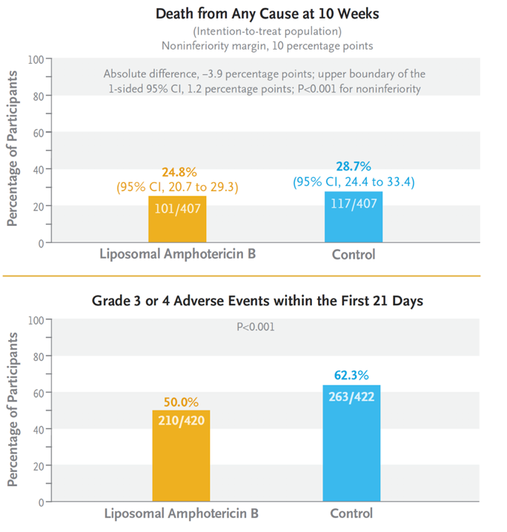
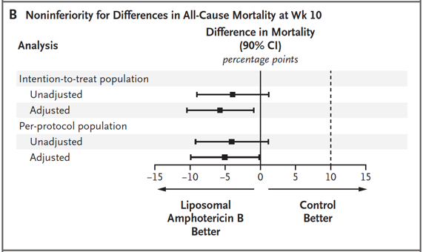
The AMBITION trial results
The novel single-dose treatment for cryptococcal meningitis was both effective and safer
Notes:
We published our final results in March of this year. The full results are shown in the panel on the left of the slide. As well as being much easier to use, our single-dose based treatment was highly effective when compared to the control arm, with about 25% of participants dying by 10 weeks with the new simplified treatment compared to 29% with conventional therapy. The new treatment was also significantly safer and less toxic, causing far fewer side-effects.

Slide 9
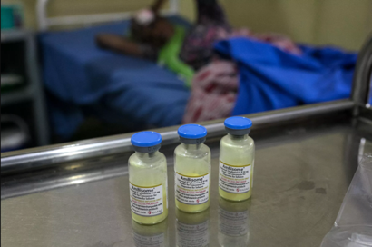
The AMBITION trial – pathway to global impact
Already being used in routine care in Botswana, Eswatini, Malawi, Mozambique, DRC, Zimbabwe, and Uganda
Published March 24th 2022
WHO Rapid Advice April 20th 2022
Photo credit: Albert Masias, MSF Access Campaign
Notes:
The publication of the full results in March 2022 were very quickly followed by an update to World Health Organization guidelines incorporating our novel single-dose regimen as first line therapy globally, with a rapid advice notice released less than one month later in April 2022, and full guidelines in July. And most importantly, people living with HIV affected by cryptococcal meningitis were receiving the new treatment in routine care settings less than 3 months after publication of our findings.

Slide 10
So many opportunities!
Dr Claire Norcross
IMPALA Trial Lead Clinician & PhD Fellow
MRC/UVRI LSHTM Uganda
Dr Daniel Trotman
Medical Education and Simulation Fellow
King’s College Hospital
Dr Ayoma Ratnappuli
Education Fellow
Centre for Sustainable Health
Dr Holly Middleditch
National Medical Director’s Clinical Fellow (GMC)
Faculty of Medical Leadership and Management
Dr Zoe Ottoway
Research MD in co-morbidities in PLWH
King’s College London

Slide 11
The Process
Identify the opportunity
Keep your Educational Supervisor and TPD in the loop, ideally with as much notice as possible
Apply >6 months prior to start
Complete OOP application form and provide supporting documents
Signature from ES and TPD

Slide 12
Summary
GUM fosters a very positive environment around OOPs
Wide range of opportunities are available both within speciality and around broader themes
They take planning and need some advance notice
Some paths are more ‘conventional’ than others but they can all work

Slide 13
THANK YOU!
david.lawrence17@nhs.net
@drdavidlawrence

