Slide 1
Inpatient HIV/GUM
Dr Franki Lander
Consultant GUM/HIV, 56 Dean Street Clinic,
Speciality Doctor, TransPlus integrated Gender Affirming Care Service
Chelsea and Westminster

Slide 2
The face of inpatient HIV
Only a few centres
Variable amount of time as a trainee covering inpatients
Some consultant jobs involve some don’t
95:95:95
Ageing population
Population of people from pre-ART era
Late presentations
Sub-optimal adherence

Slide 3
Inpatient HIV
Opportunistic infections
HIV related oncology
General medicine
Daycase HIV
Follow up
Minor infections
Bisphosphonates
Chemo and chemo related care

Slide 4
Inpatient GUM
Gonococcal arthritis
Retention secondary to HSV
Daycase GUM
Neurosyphillis

Slide 5
PCP
Pneumocystis Jirovecii
90% of cases in CD4 <200
Exertional dyspnoea
Interstitial infiltrates
Induced sputum or BAL
Co-trimoxazole +/- steroids
Prophylaxis <200/<14%

Slide 6
MAC
Mycobacterium avium complex
Typically CD4 <50
Azithromycin prophylaxis
Focal or disseminated
Disseminated can have non-specific symptoms e.g fever, weight loss, lymphadenopathy
Blood culture, LN bx, bone marrow
Overlap in TB treatment- need to review ARV’s

Slide 7
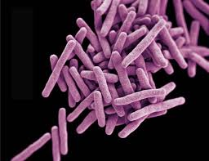
TB
Interaction with ARVs
Delaying ARV’s
Smear of body fluid
Culture and differentiation
Drug susceptibility tests (molecular testing)
Negative PCR does not exclude
Respiratory +/- milliary
Cerebral
Spinal
TB IRIS

Slide 8
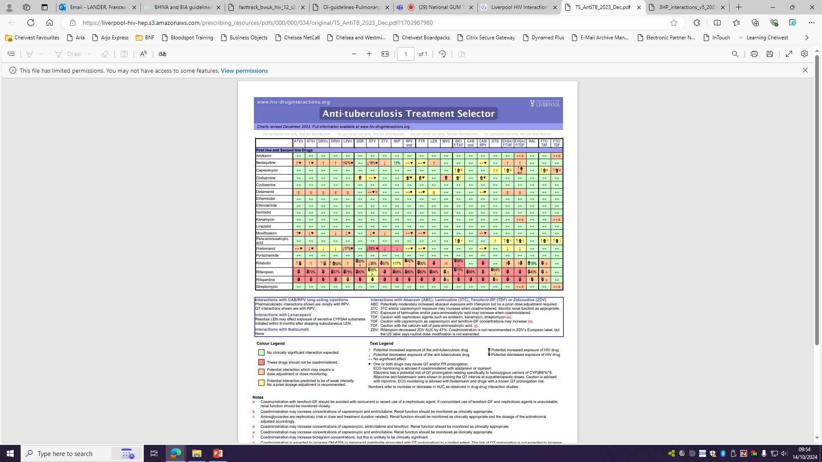

Slide 9
Toxoplasmosis
Most common in CD4 <200
prophylaxis
Toxoplasma Gondii
Eating animals with disseminated infection or oocytes from cat faeces
Often reactivation of chronic infection from earlier
Focal and generalised neurology
Confusion, altered consciousness
Can involve spinal cord
MRI –ring enhancing, oedema
CSF
CNS lymphoma differential
Treat with pyrimethamine, sulfadiazine and folinic acid
Steroids if signs of raised ICP +/- antiepileptics

Slide 10
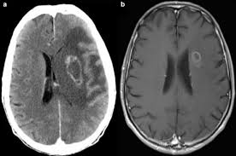

Slide 11
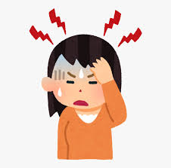
Cryptococcal Meningitis
Encapsulated yeast
Inhaled, can be localised lung disease (less common in HIV)
Haematological spread
Headache, fever, raised ICP
Serum cryptococcal antigen
LP- also send for fungal culture
Blood culture
Amphotericin B + flucytosine
fluconazole
Risk of IRIS

Slide 12
Progressive multifocal leukoencephalopathy
Disease of white matter
Demyelination
Progressive
Decreased coordination, weakness, speech, visual, personality changes,
JC virus in CSF
Progressive MRI changes

Slide 13
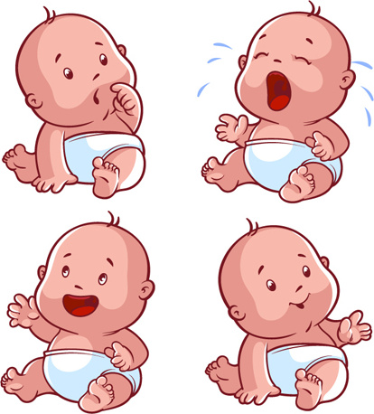
HIV in pregnancy
HIV testing in pregnancy
ARV’s safety in pregnancy
Hyperemesis gravidarum
Mode of delivery
ARVs for baby
Post- partum care

Slide 14
Lymphomas
Diffuse large B cell lymphoma
Burkitts lymphoma
Primary effusion lymphoma
Plasmabastic lymphoma
Primary CNS lymphoma
Hodgkins lymphoma

Slide 15
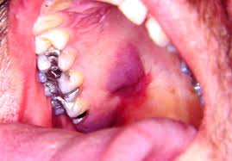
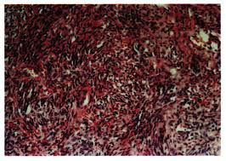
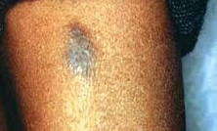
Kaposis sarcoma
Most common tumour in PLWH
KSHV/ HHV8
Cutaneous or mucosal
Can also be visceral
Biopsy
Imaging
Start ARV’s
Intralesional vinblastine/ RT
Chemo if visceral/disseminated

Slide 16
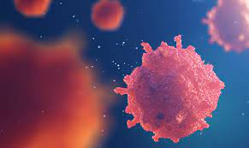
Castlemans disease
HHV8 related
Lymphoprolferative- not cancer
Focal vs multicentric
Multicentric more common in PLWH
B symptoms, hepatosplenomegaly
Pancytopenia
Haemophagocytosis (bone marrow)
CT scan- lymphadenopathy, organomegaly
LN bx- HHV8, IgM lambda
Serum HHV8 to support diagnosis and for monitoring for relapse

Slide 17
Other HIV related malignancies
Cervical ca (CIN)
Anal Ca (AIN)

Slide 18
Procedures
Lumbar punctures
Skin biopsies
Ascitic taps/drains
Pleural taps/drains
Bone marrow biopsies

Slide 19
HIV and mental health
Stigma
Drug use
Chemsex
CNS effects of ARVs
CNS effects of syphilis
LGBTQIA+ link to mental health and suicide
Pre-existing mental health
The prevalence of mental health conditions remained high and unchanged since 2017, with approximately 2 in 5 people (39.4%) having been diagnosed with at least one of these conditions (37.4% in 2017). This is substantially higher than in the English general population with just over a quarter (26.4%)- Positive Voices, 2023

Slide 20
Specialist clinics
Oncology
Hepatitis
Vulval dermatology
Penile dermatology
HIV neurology
HIV renal
Over 50’s
Trans/non-binary health
Gynae block
Micro lab
Complex GUM
Erectile dysfunction
LARC
Antenatal HIV
Virtual Clinic
Paediatric HIV

Slide 21
Thanks, any questions?
f.lander@nhs.net
References: BHIVA GUIDELINES, BASHH GUIDELINES

